Slide 1
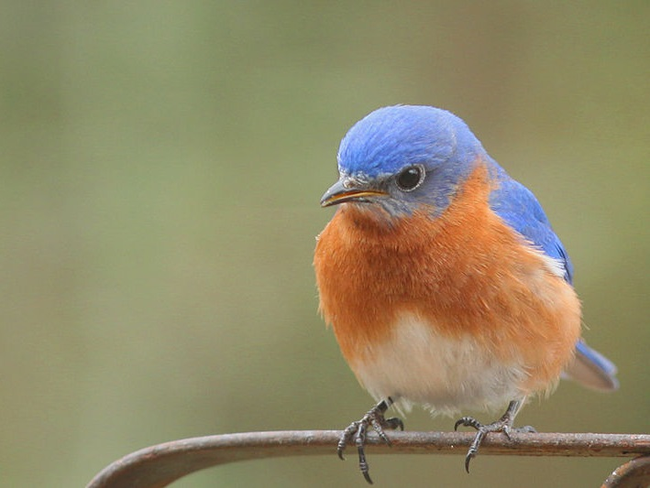
Bluebird Basics
Joan Eckhardt
Notes:
Ohio Bluebird Society, Inc. (OBS) was formed in 1987 for the purpose of supporting the return and the perpetuation of the Eastern Bluebird and other native cavity nesting birds in Ohio. To this end, OBS strives for the best methods to use, conserve and create habitat for the protection of these birds.

Slide 2
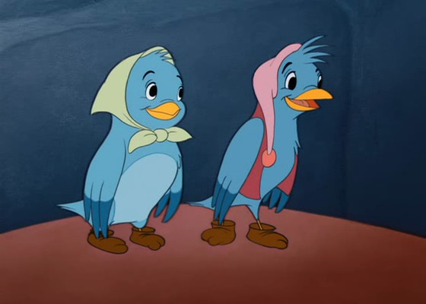
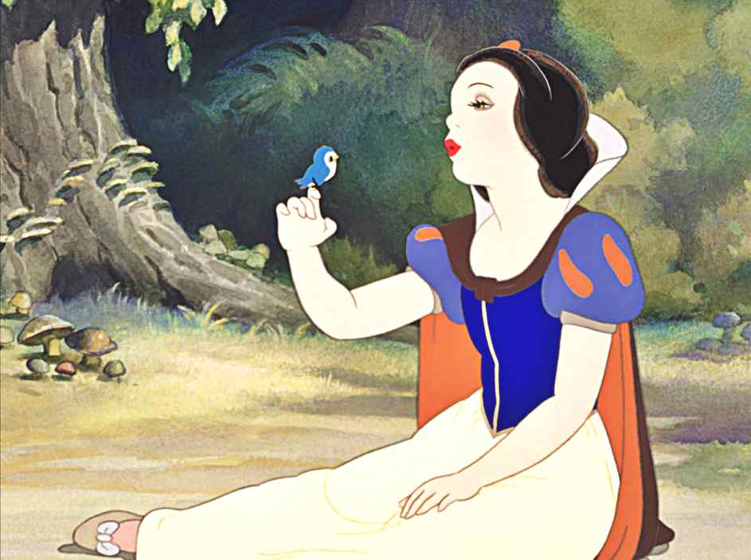
Notes:
Bluebirds are beloved visitors to our backyards and have long been symbols of joy and hope. During this program we will discuss the natural history of the bluebird and what you can do to help protect these birds.

Slide 3
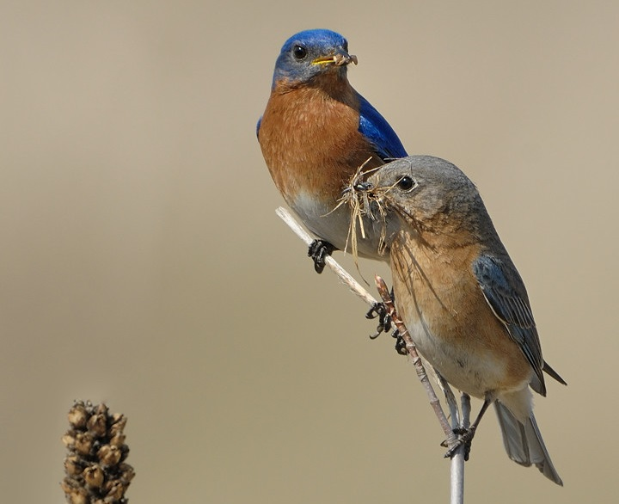
Notes:
Bluebirds are members of the thrush family which also includes the robin. The males are a more vibrant blue. The females are a paler grey tinged with blue.

Slide 4
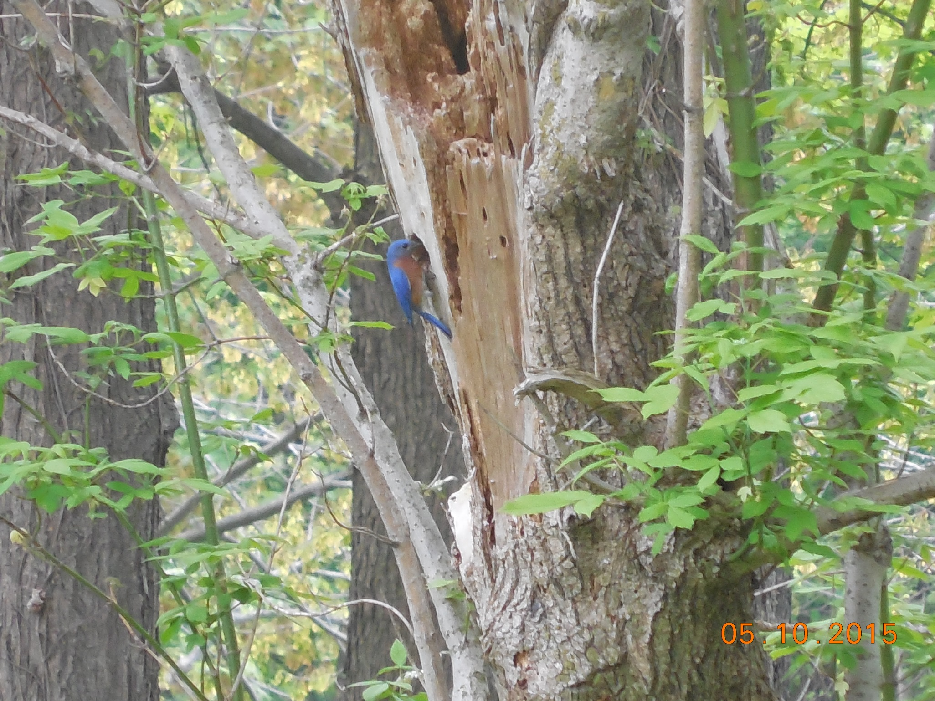
Penny Brandau
Notes:
Bluebirds are secondary cavity nesters. This means they use existing cavities either naturally occurring or excavated by other birds or squirrels.

Slide 5
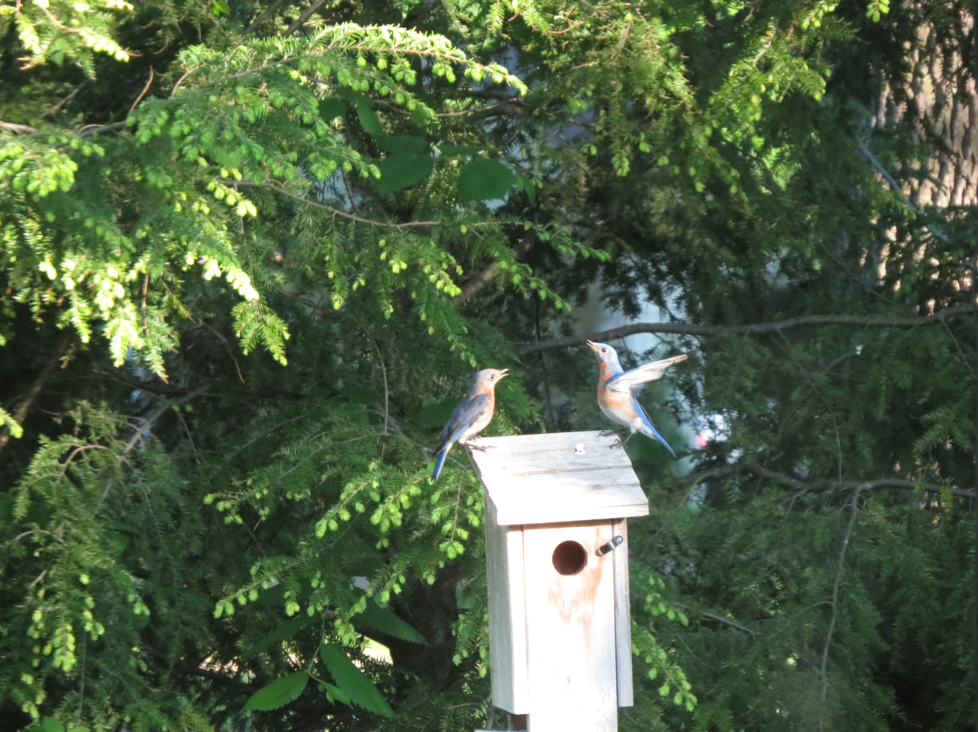
Penny Brandau
Notes:
The male Eastern Bluebird displays at his nest cavity to attract a female. He brings nest material to the hole, goes in and out, and waves his wings while perched above it. That is pretty much his contribution to nest building; only the female Eastern Bluebird builds the nest and incubates the eggs. (cornell copy).

Slide 6
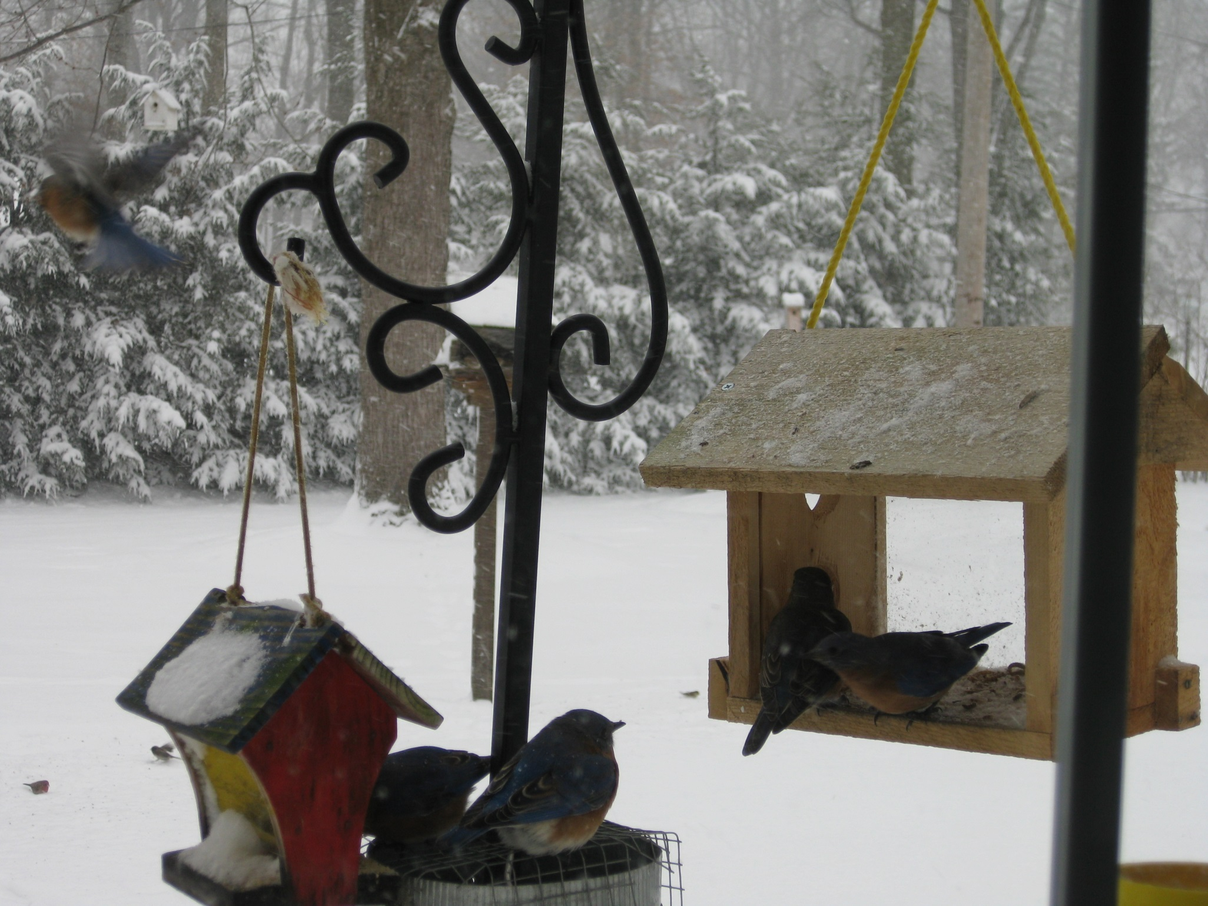
Penny Brandau
Notes:
Eastern Bluebirds typically have more than one successful brood per year. Young produced in early nests usually leave their parents in summer, but young from later nests frequently stay with their parents over the winter. (cornell copy)

Slide 7
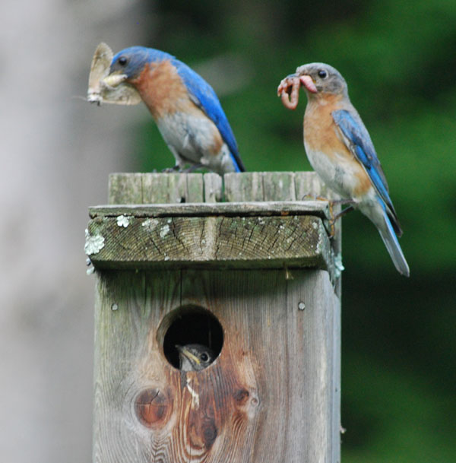
Notes:
Both parents help in feeding the young

Slide 8
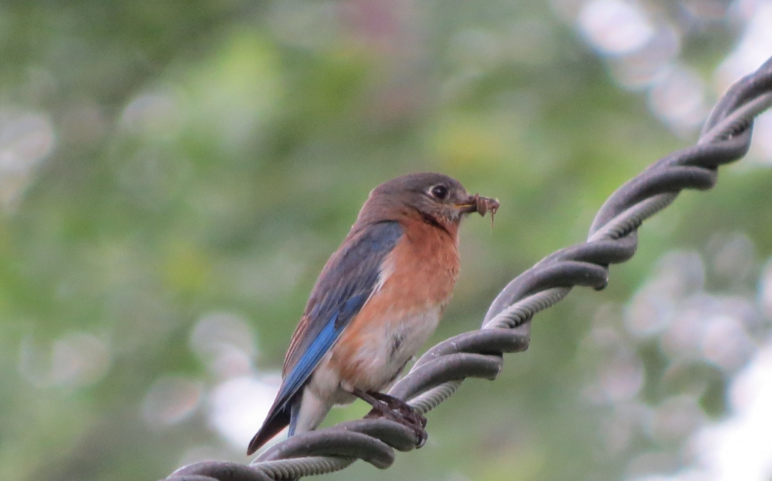
Penny Brandau
Notes:
Insects caught on the ground are a bluebird’s main food for much of the year. Major prey include caterpillars, beetles crickets, grasshoppers, and spiders. In fall and winter, bluebirds eat large amounts of fruit including mistletoe, sumac, blueberries, black cherry, tupelo, currants, wild holly, dogwood berries, hackberries, honeysuckle, bay, pokeweed, and juniper berries. Rarely, Eastern Bluebirds have been recorded eating salamanders, shrews, snakes, lizards, and tree frogs.(cornell copy)

Slide 9
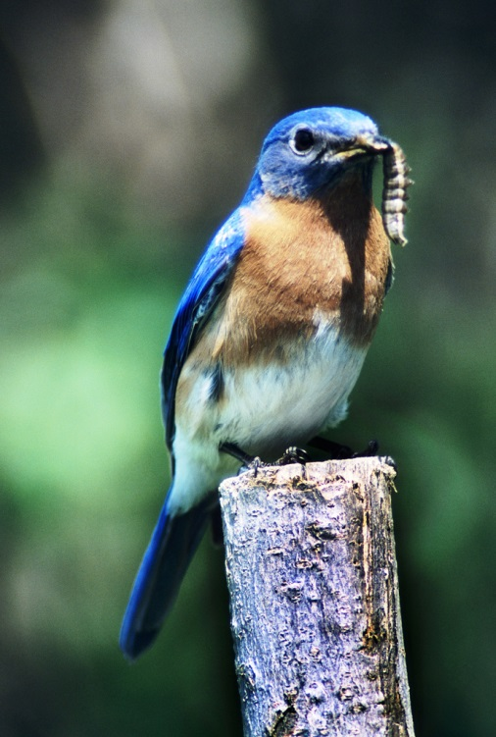
Herbert Lange
Notes:
Bluebird populations increased as Ohio forests were turned into farm fields and pastures. Not only did this create a new source of food (ground dwelling insects in these fields), but the fence posts create a wonderful new set of cavities for nesting.

Slide 10
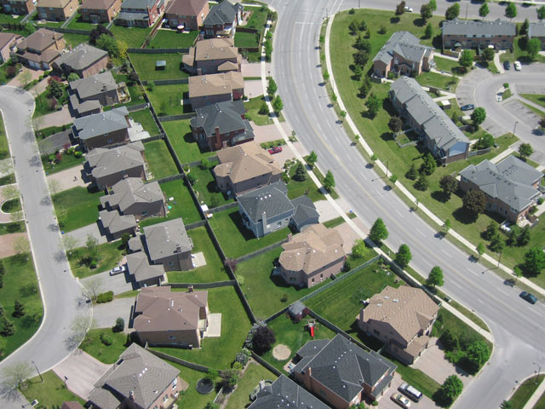
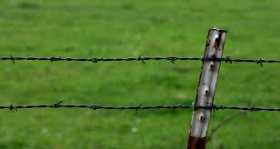
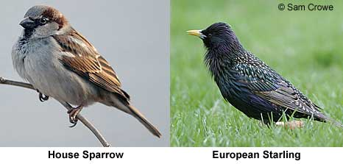
Notes:
(house sparrow, starling, urban development, steel fence post) So what went wrong for the Bluebird? As human populations increased open areas decreased, standing dead trees were considered unsightly. Introduced species like the starling and house sparrow began competing for dwindling cavities, and farmers switched from wooden posts to steel. Pesticide use increased, reducing the number of healthy insects for the birds to feed on. This resulted in losses of up to 90% of the population.

Slide 11
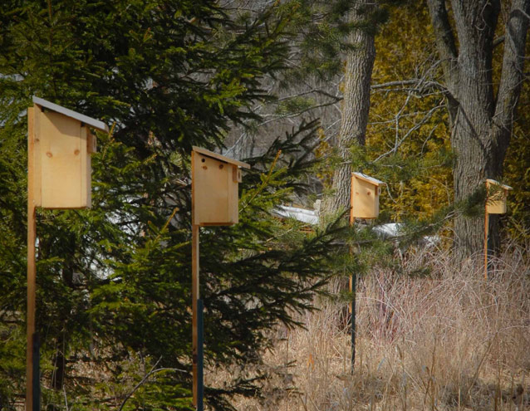
Notes:
People became concerned about the loss of the bluebirds and began looking for ways to help them. Artificial nest boxes and nest box trails were developed in the 1930 to provide nesting sites.

Slide 12
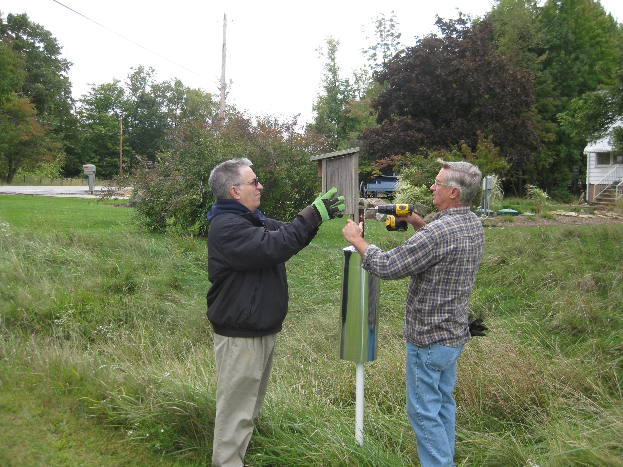
Penny Brandau
Notes:
Today thanks to the concern and hard work of many bluebird enthusiasts, Eastern Bluebird populations increased by almost 2 percent per year between 1966 and 2010, according to the North American Breeding Bird Survey.

Slide 13
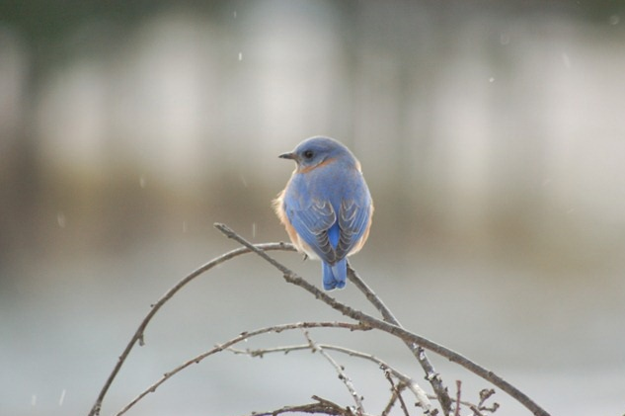
Marcella Hawkins
Notes:
How can you get involved? Whether you decide to put up one box in your backyard or create “Bluebird Trail” Of 5 or more boxes, you can make a difference.

Slide 14
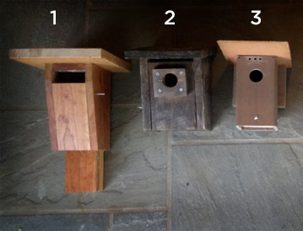
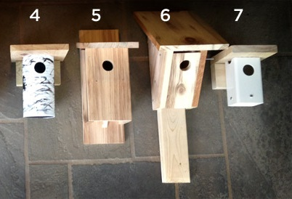
Notes:
There are any different styles of nesting boxes. All have advantage and disadvantages and the choice of box is largely one of personal choice. No matter what your decision, all boxes should have a few things in common.
These Bluebird boxes have been carefully designed to keep your Bluebirds safe and dry. We use materials and construction methods that will give you and your Bluebirds years of enjoyment.
1. Sparrow resistant Bluebird slot box 2. F&M Front opening box 3. Trex model with Cedar roof 4. PVC round model 5. NABS (North American Bluebird Society) model 6. Pederson 7. PVC square “mini box”

Slide 15
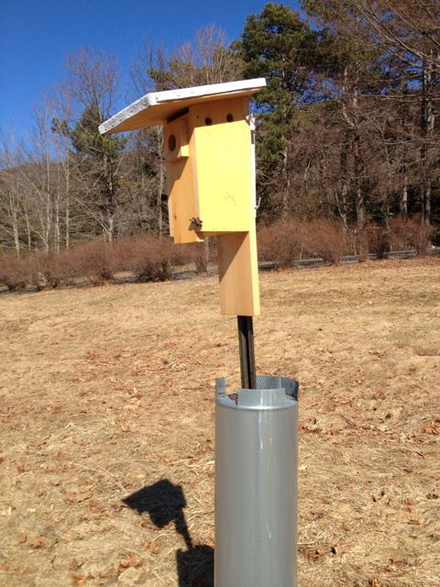
Well ventilated
1 ½ inch hole
Clean-out opening
Well drained
Predator guard
Notes:
Boxes should be:
Well drained
Well ventilated
1.5 inch hole
Pred guard
Placed in open lawn

Slide 16
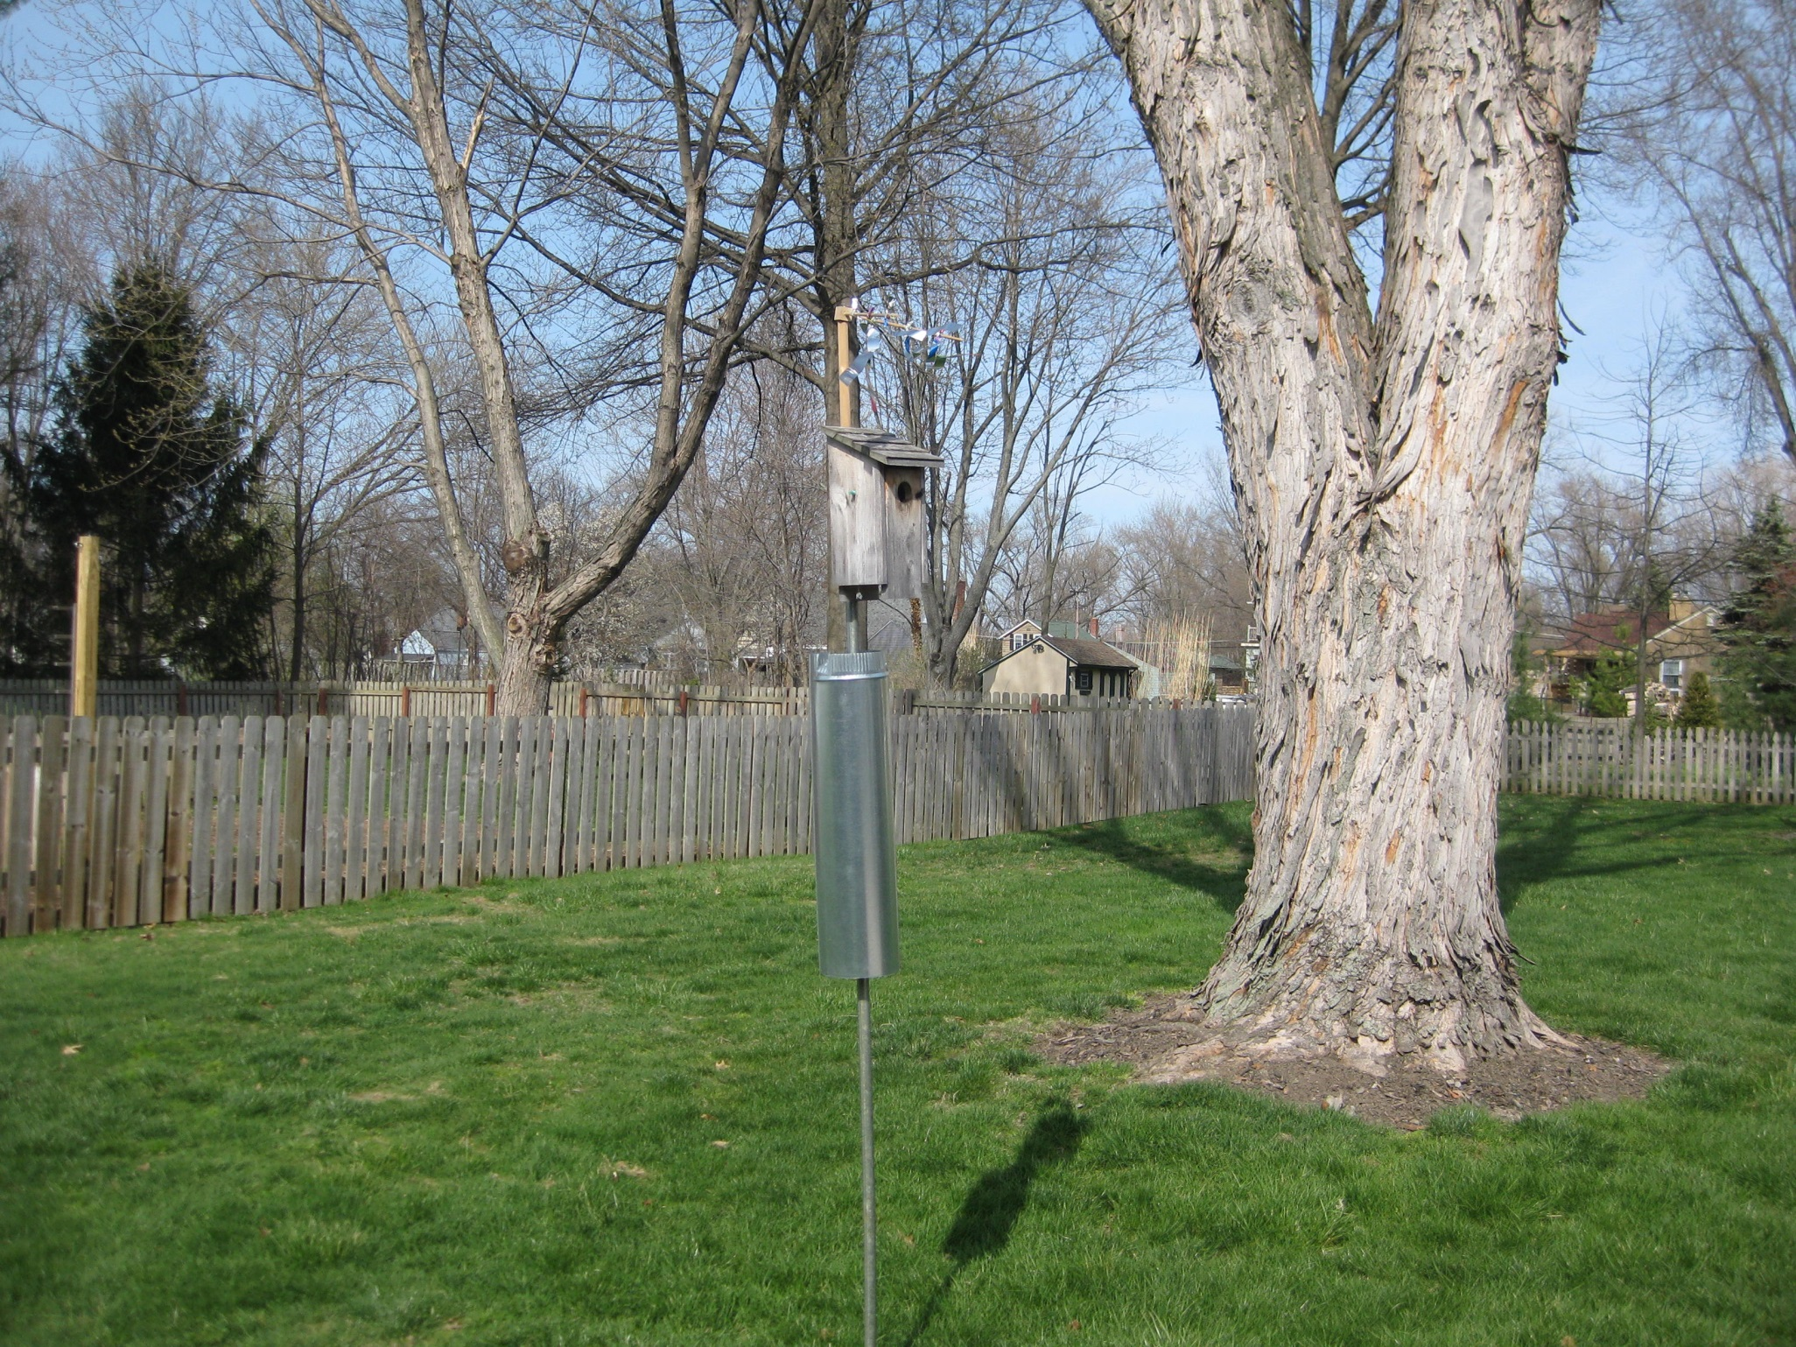
Notes:
Boxes should be placed in open lawns or areas of short grass.

Slide 17
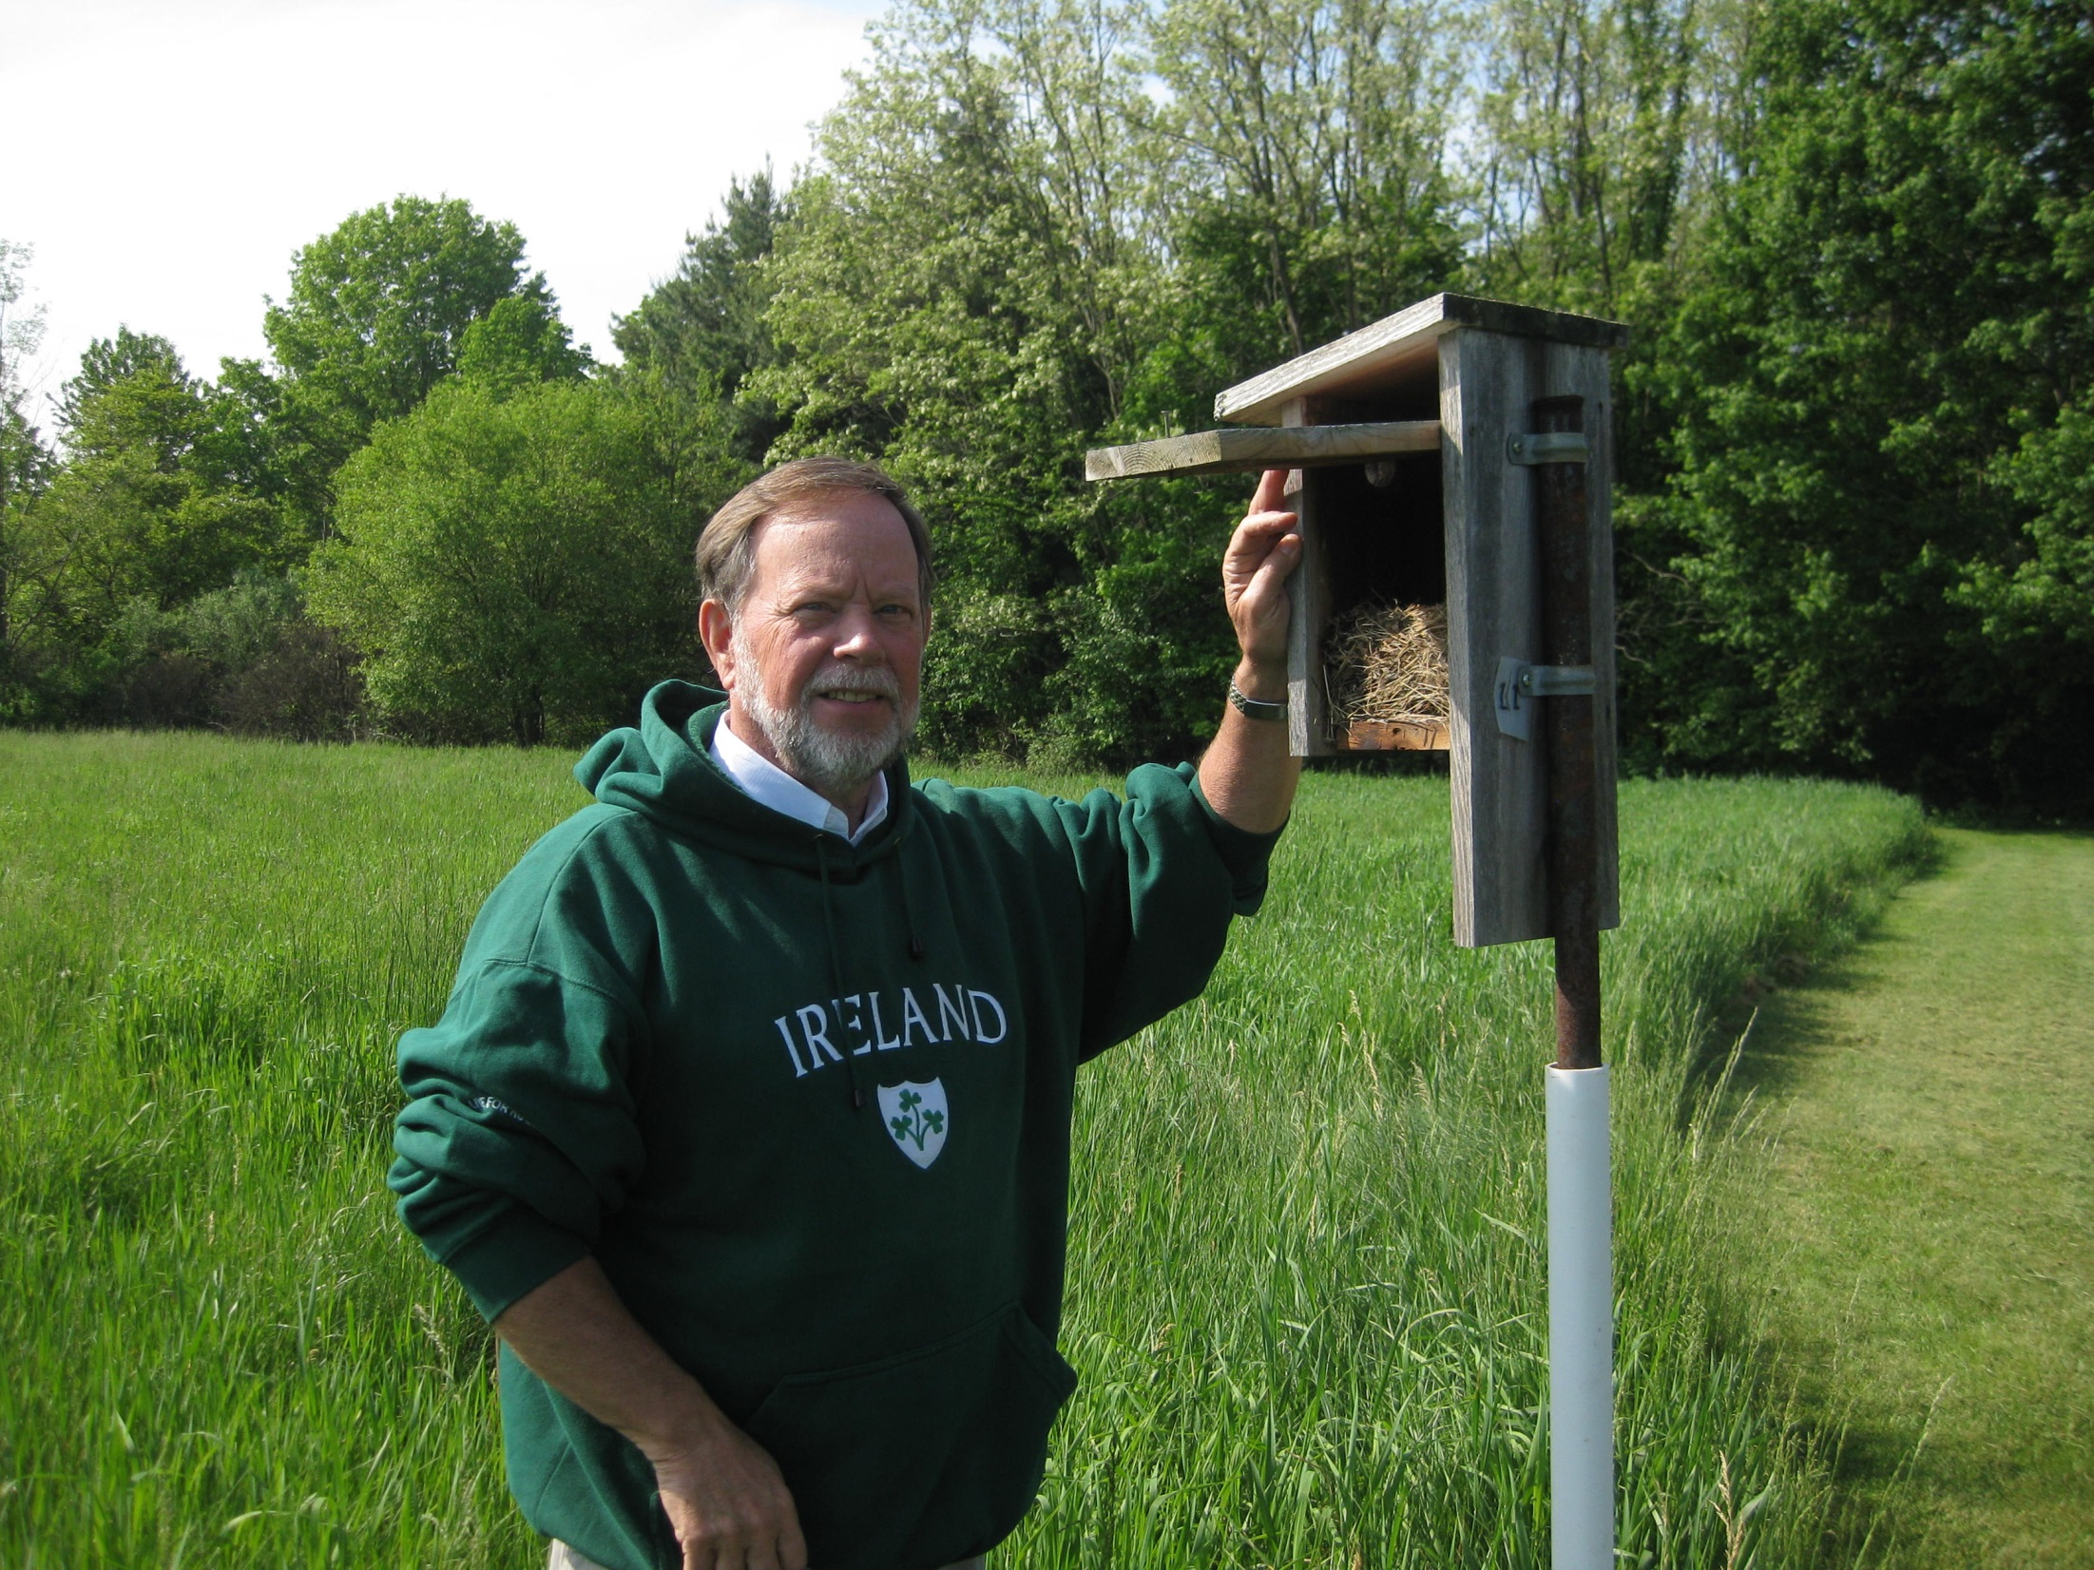
Notes:
It is important to monitor you boxes. Here’s what you can expect to see once your bluebird s nest:

Slide 18
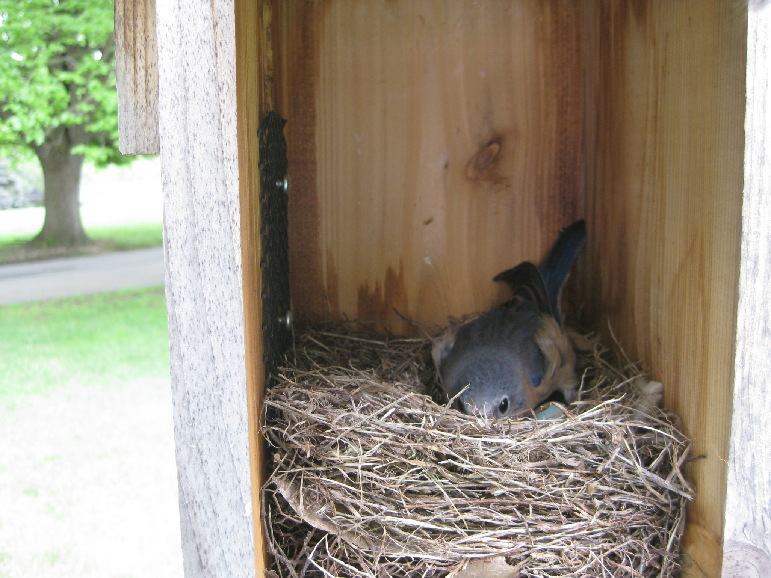
Notes:
Incubation lasts 12-14 days

Slide 19
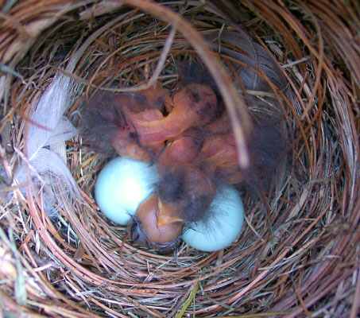
Notes:
Eggs hatch

Slide 20
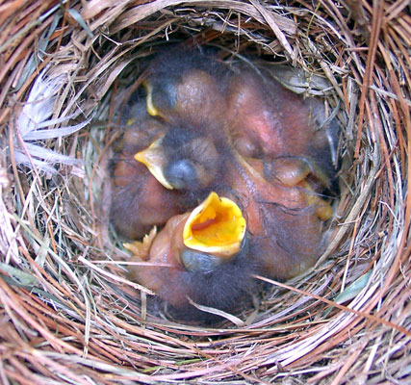
Notes:
Once babies hatch, parents will feed them twice each hour

Slide 21
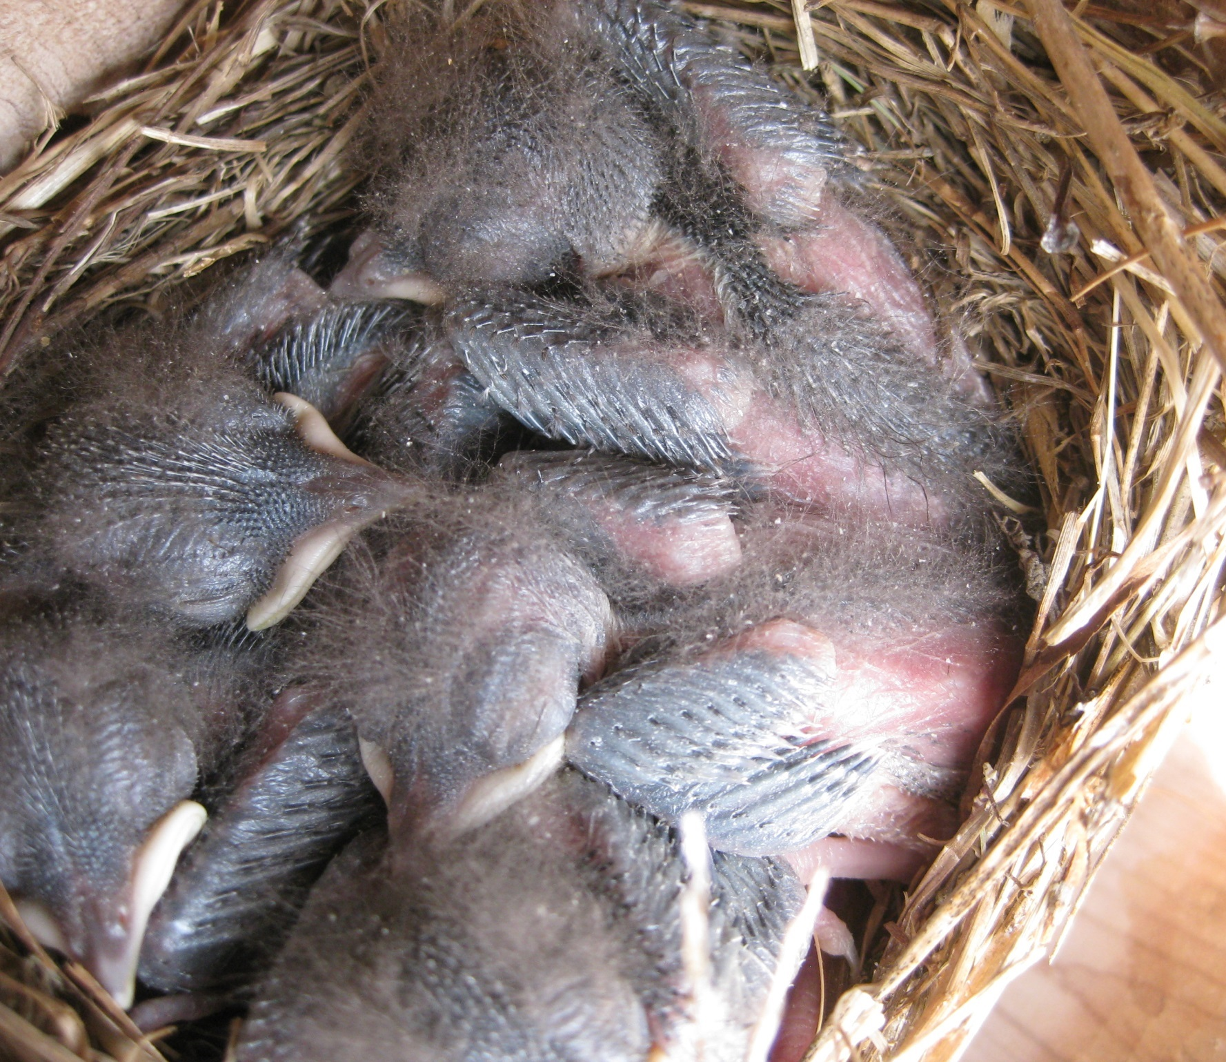
Notes:
Feathers appear by the end of the first week

Slide 22
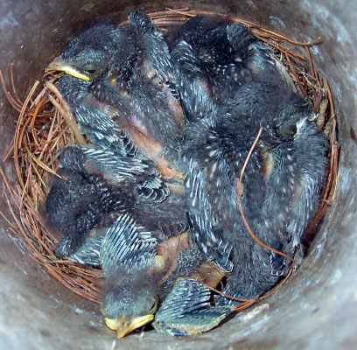
Notes:
A few days later, the young open their eyes for the first time

Slide 23
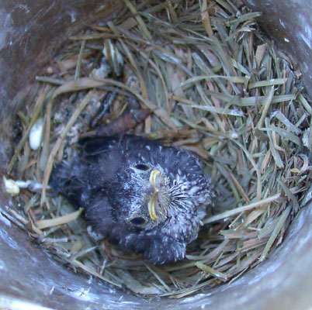
Notes:
After 18-20 young will leave the nest. Parents will continue to care for them for several weeks and they learn to catch insects on their own

Slide 24
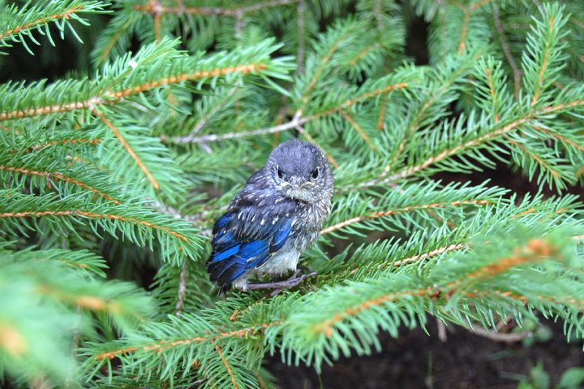
Vicki Mountz
Notes:
Parents will continue to care for them for several weeks and they learn to catch insects on their own

Slide 25
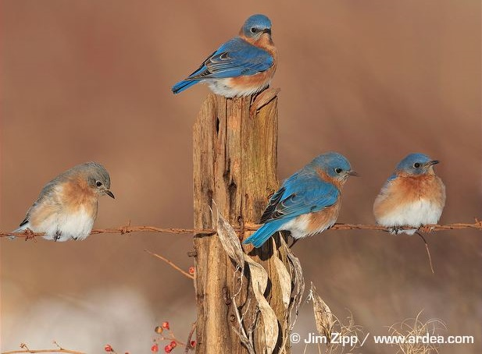
ohiobluebirdsociety.org
Notes:
If you would like to learn more about these wonderful birds, visit the Ohio Bluebird Society’s website.

